Slide 1
Study Group 8

Slide 2
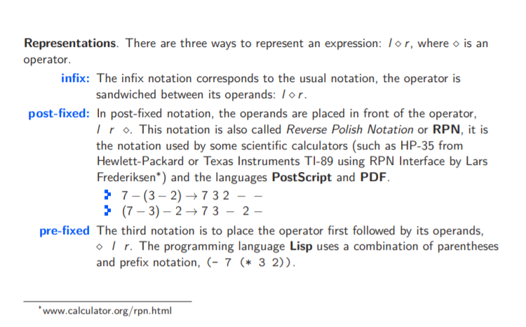

Slide 3
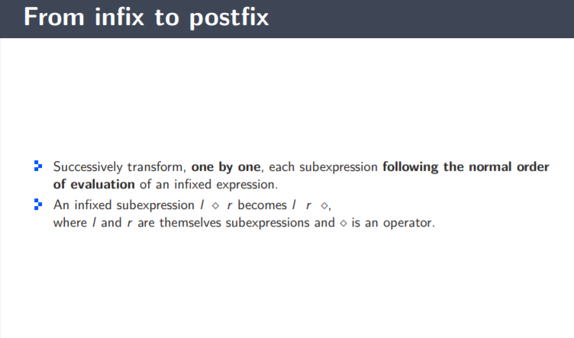

Slide 4
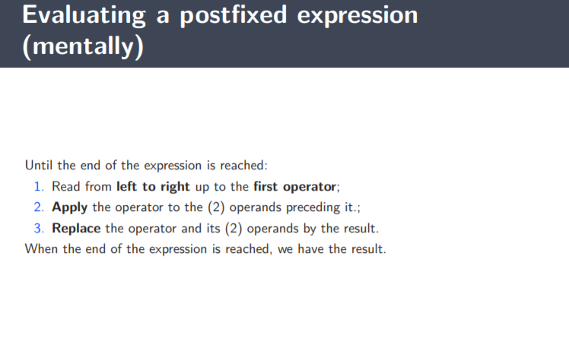

Slide 5
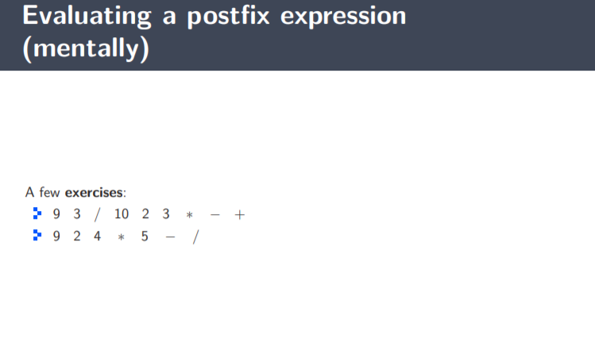

Slide 6
9 3 / 10 2 3 ∗ − +
9 2 4 ∗ 5 − /

Slide 7
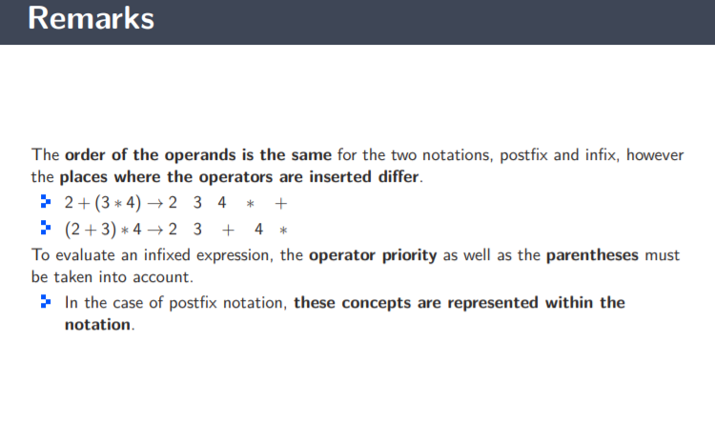

Slide 8
9 3 / 10 2 3 ∗ − +
9 2 4 ∗ 5 − /

Slide 9
Slides and exercises can be found here:
https://www.site.uottawa.ca/~turcotte/teaching/iti-1121/lectures/index.html

Slide 10
Queue using Stacks
We are given a stack data structure with push and pop operations, the task is to implement a queue using instances of stack data structure and operations on them
A queue can be implemented using two stacks. Let queue to be implemented be q and stacks used to implement q be stack1 and stack2. q can be implemented in two ways.

Slide 11
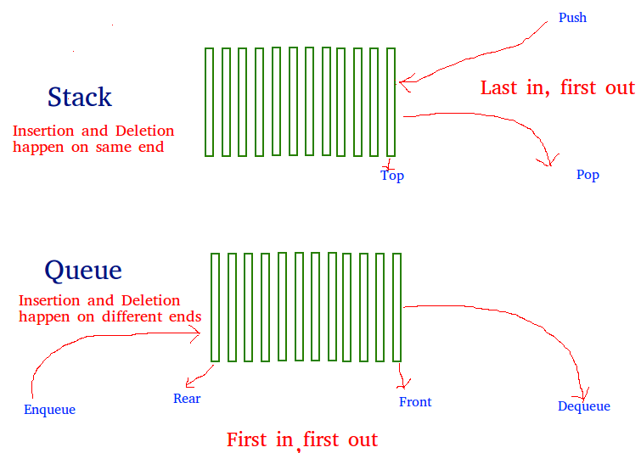

Slide 12
For more information:
https://www.geeksforgeeks.org/queue-using-stacks/

Slide 13
MAX and MIN
Write a method that takes a stack and returns the max element in it. The state of the input has to be the same before and after.
Same question but with min.
Same 2 questions but with queue

